Slide 1

Green Pace
Security Policy Presentation
Developer: Matthew Trembley
Notes:
Welcome everyone to my presentation dealing with a new security policy for our company. For those who don’t know me, my name is Matthew Trembley and I am a developer here at Green Pace.

Slide 2

OVERVIEW: DEFENSE IN DEPTH
Consistent implementation of
Security principles
Coding Standards
Triple-A framework
Data Encryption
Purpose:
Mitigate and eliminate threats from multiple angles
Protect customer data
Notes:
A short overview of today’s presentation has to deal with Defense in Depth. What I mean by this is having various layers of security within our development projects. Today’s presentation will send of message of consistency with security principles and coding standards, as well as touching on the Triple-A framework and data encryption. The whole idea behind all this is to mitigate and eliminate threats from multiple angles and protect our customers and their data.

Slide 3
THREATS MATRIX
Likely vulnerabilities and corresponding standards with priority ranking
Unlikely vulnerabilities and corresponding standards with priority ranking
Likely STD-003-CLG STD-004-CPP STD-005-CPP STD-006-CPP | Priority P18 P18 P18 P9
Unlikely STD-001-CLG STD-009-CPP | Low priority P3 P4
Notes:
Here we have our threat matrix, consisting of likely and unlikely vulnerabilities and the corresponding standards, as well as a priority for each. The different standards will be addressed shortly.

Slide 4
10 PRINCIPLES
1. Validate Input Data | [STD-001-CLG], [STD-002-CLG], [STD-003-CPP], [STD-004-CLG], [STD-009-CPP]
2. Heed Compiler Warnings | [STD-001-CLG], [STD-002-CLG], [STD-005-CPP]
3. Architecture and Design for Security Policies | [STD-004-CLG], [STD-007-CPP], [STD-008-CPP], [STD-010-CLG]
4. Keep it Simple | [STD-001-CLG]
5. Default Deny | [STD-004-CLG]
6. Adhere to the Principle of Least Privilege | [STD-004-CLG],
7. Sanitize Data Sent to Other Systems | [STD-003-CPP], [STD-004-CLG]
8. Practice Defense in Depth | [STD-001-CLG], [STD-002-CLG], [STD-003-CPP], [STD-004-CLG], [STD-006-CPP]
9. Use Effective Quality Assurance | [STD-005-CPP], [STD-006-CPP], [STD-007-CPP], [STD-008-CPP], [STD-009-CPP], [STD-010-CLG]
10. Adopt a Secure Coding Standard | [STD-005-CPP], [STD-006-CPP]
Notes:
Here we have the 10 security principles to be enacted and followed, as well as the standards that deal with them. (go through the list)

Slide 5
CODING STANDARDS
Standard Label | Coding Standard | Rank by Priority
STD-001-CLG | Data Types – Declare all variables and functions before using them. Do not allow implicit declarations. DCL31-C | 3
STD-002-CPP | Data Values – Do not read uninitialized variables. EXP53-CPP | 12
STD-003-CPP | String Correctness – Guarantee that storage for strings has enough space for character data and null terminator. STR50-CPP | 18
STD-004-CLG | SQL Injection – Always use prepared statements for querying. FIO30-C | 18
STD-005-CPP | Memory Protection – Do not allow access to free memory. MEM50-CPP | 18
STD-006-CPP | Assertions – Use assertions to test assumptions such as if a pointer is NULL or not. If the expression evaluates to false, the abort() function is called to prevent unexpected behavior. ERR56-CPP | 9
STD-007-CPP | Exceptions – Handle all exceptions. ERR51-CPP | 4
STD-008-CPP | Containers – Use valid iterator ranges. CTR53-CPP | 6
STD-009-CPP | Input/Output – Close files when they are no longer needed. FIO51-CPP | 4
STD-010-CLG | Arrays – Ensure size arguments for variable length arrays are in a valid range. ARR32-C | 9
Table shows each coding standard in ascending order.
Rank by Priority is from https://wiki.sei.cmu.edu/confluence/display/c/SEI+CERT+C+Coding+Standard within each corresponding standard.
Notes:
Now here are the 10 coding standards, listed in ascending order. (go through each standard). Each rank is taken from Software Engineering Institute at Carnegie Mellon University’s standards. As you can see, each standard description is followed by an alphanumeric code which is a link to the related standard.

Slide 6
ENCRYPTION POLICIES
Data at rest
Protected when stored
Computer
Cloud
Database
Many different tools to ensure encryption
AxCrypt
BitLocker
IBM Guardian
Protect data from being physically or virtually stolen
Data in flight
Protect when moving from one place to another
Many different tools to ensure encryption
S/MIME
Web traffic should be sent over secure sockets layer
SSL/TSL/HTTPS certificate from authorized issuer.
Data in use
Protected while being
Created, accessed, edited, or viewed
Between in-flight/at-rest
Generally, when accessing a website on a server or while CPU is busy
Important because memory can be insecure and hacked.
Notes:
So let’s talk about data encryption. There are 3 different states of data. Data at rest, data in flight, and data in use. Each state has their own attributes and tools to keep data safe. Data at rest needs to be protect when it is stored. This data can be on a personal computer, on the cloud, or in a database and this type of data can use specific tools to ensure encryption. These tools are third party software such as AxCrypt, BitLocker, or IBM Guardian. This prevents theft of data either physically or virtually. Data in flight is when data is moving from one place to another. A tool that can be utilized is an S/MIME certificate, which helps protect MIME data like emails. Another defense is sending web traffic over a secure socket layer with a certificate like SSL/TSL/HTTPS from authorized issuer. Data in use is when data is being created, accessed, edited or used. This is the state in between in flight and at rest. This is most often while accessing a website on a server or while the CPU is busy. Protecting data in use is important because memory can be insecure and therefore be hacked.

Slide 7
TRIPLE-A POLICIES
Authentication
Answers: “Who are you?”
Verify user and their credentials
Multi-factor authentication
Biometrics
All users shall be verified.
If not authenticated, potential for identify theft/unauthorized access is increased.
Authorization
Answers: “What can I do?”
Level of access
Files, directories, applications
Each user shall of ability to read, write, and/or execute
Role dependent
Accounting
Answers: “What exactly happened and when did it happen?”
Record keeping – logs
Logins, new users, access events, or database events
All actions shall be timestamped
Notes:
Now the Triple-A framework is authentication, authorization, and accounting. Authentication answers the question “Who are you?”. It is important to verify every user and their credentials, and this can be done numerous ways. Some more high-level ways are multi-factor authentication or even biometrics. It is very important that ALL users be verified. If not all are, there is a much higher risk for identity theft or unauthorized access. Authorization answers the question “What can I do?” This deals primarily with levels of access to things like files, directories or even applications. Each user shall of an ability to read, write, and/or execute but it all depends on their role within the company. An administrator may have the ability to block certain applications, or access certain databases that may have sensitive information, where a customer service representative may not. Accounting will answer the questions “What exactly happened and when did it happen?”. It is essentially record keeping, like using logs. Different logs for events like logins, new users, access events, or database events. Also, all actions shall be timestamped to further achieve that accountability for all actions.

Slide 8
Unit Testing
The following slides are of unit testing of out-of-bounds access on a container.
Notes:
Now the next few slides have to do with unit testing, a seriously important aspect to this new security policy. With unit testing, we have the ability to find bugs much sooner, especially ones that could be detrimental to a product. (go through each one)

Slide 9
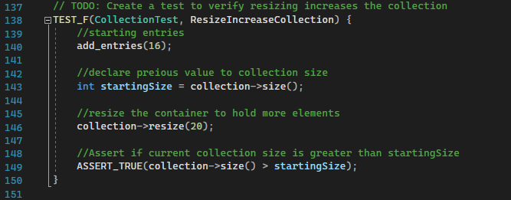
Resize Collection by Increase Out of bounds check
Start by adding 16 elements to container
Declare a size of the starting size
Proceed to resize the container
Recheck the size of container

Slide 10
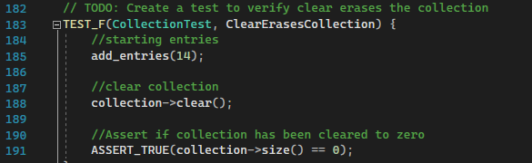
Clear erases container Out of bounds check
Start by adding elements to container
Clear the container
Recheck container size

Slide 11
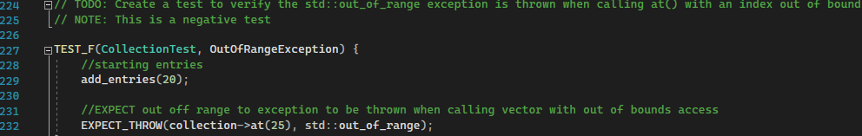
Throw “Out of Range” Exception Out of bounds check
Start by adding elements to container
Throw “out of range” exception while trying to access an element not included in container.

Slide 12
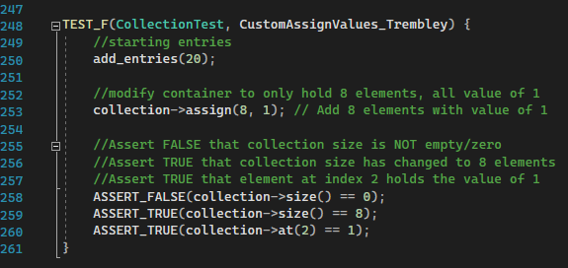
Custom Assign Elements Out of bounds check
Start by adding 20 elements to container
Assign 8 elements all with a value of 1
Recheck the following
Size is NOT 0
Size is now 8
Value at index 2 is equal to 1

Slide 13

AUTOMATION SUMMARY
Notes:
Now automation fits right into the software development lifecycle. It will find itself right at home within DevSecOps, where security and testing is forefront. This diagram creates a great flow of the SDLC.

Slide 14
TOOLS
Automation can be incorporated with “Build”
Compilation and static checking into CI/CD pipeline
Verify and test in SecOps
Virtual deployment
Implement automated tests
Effective quality assurance tests
OWASP Dependency-Check
Tools to be considered:
CppChecker
Parasoft
Coverity
Jenkins
Docker
Gitlab
Notes:
There are many tools that can used within automation. It can be considered with “builds” of software, where compilation and static checking works right into the continuous integration/continuous delivery. Tests can be automated, which can save the company a lot when it comes to labor. Other tools can be the OWASP Dependency check, an organization dedicated to checking dependencies on various libraries. Other tools to be considered are: (name list)

Slide 15
RISKS AND BENEFITS
A huge risk is cost
It is more expensive to fix a bug later rather than sooner
Fix during design, not during maintenance
6x more expensive found during implementation
15x more expensive found during testing (How expensive are bugs to fix?, 2021)
Many resources on Secure Coding
Secure Coding by Design
SEI CERT Coding Standards
Document possible or known threats
Rank
Prioritize
Address them
Notes:
There are many risk and benefits to this security policy. The risks deal with not having it in the first place. The most pressing issue is cost. It is more expensive to fix a bug later rather than sooner, as it should be fixed during the design phase and not the maintenance phase. It is 6x more expensive found during implementation, and 15x more expensive if found during testing. There are many resources on secure coding to reduce the risk of security issues. It will also be important for us to document possible or known threats by ranking, prioritizing, and addressing them as they come up.

Slide 16
RECOMMENDATIONS
Consider all motives for a potential attack
Also consider security of the machines and API’s we use internally
Consider cloud security and further define “defense in depth”
Security layers:
Assets
Data
Applications
Network
Physical
Cloud
Notes:
My recommendations are: let us enact this policy asap. Also, it is important to consider all the motives for potential effects. Having an understanding of why or where these attacks can come from can help us all in become better developers and coding securely against these threats. It is also important to consider the security of the machines, API’S and applications we use internally as a company. Another consideration is for cloud security, and for us to further define “Defense in depth” with many security layers. These items to be protected are assets, data, applications, networks, physical properties, and cloud information.

Slide 17
CONCLUSIONS
Consider Cloud Security as an addition to security assets
Understand and identify security controls
IT team – network security
Stay current with resources on current standards
Quickly adopt a company wide security policy to stay ahead of current threats
Notes:
We can consider cloud security as an addition to security assets. It is also understand and identify security threats from an IT perspective – like how our internal network is set up and protected. It is equally important to stay current with all the available resources on current industry standards. Last, it is vital we adopt this company wide security policy to stay ahead of current threats.

Slide 18
REFERENCES
Saini, A. (2021, October 21). How much do bugs cost to fix during each phase of the SDLC? Application Security Blog. Retrieved December 2022, from https://www.synopsys.com/blogs/software-security/cost-to-fix-bugs-during-each-sdlc-phase/
SEI Cert Coding Standards. SEI CERT Coding Standards - CERT Secure Coding - Confluence. (n.d.). Retrieved December 2022, from https://wiki.sei.cmu.edu/confluence/display/seccode/SEI+CERT+Coding+Standards

